Slide 1

503IT COMMUNICATION & COLLABORATION
CYBER RUN
A 4-Week Journey Developing a Gamified Phishing Awareness Platform
The Avenger • Vivek, Hangma, Hadshen, Swastika, Arbaaz

Slide 2



WEEK 1 AT A GLANCE
Project Ignition Tasks:
03
01
Git Organization Structured shared repository setup.
Team & Role Allocation Formed 'The Avengers' & assigned project jobs.
04
Project Plan Established deliverables, loops, and timeline milestone formulas.
02
Audience Alignment Targeted 18-25 university students for anti-phishing.

Slide 3

PROJECT IGNITION: THE VISION
The Cyber Run game
Learning Objectives
Designed to help bridge the knowledge gap in traditional, dry cyber security modules.
Instruct players on how to quickly spot fraudulent subdomains, identify suspicious senders, and practice instant reporting protocols.
University networks suffer high-frequency phishing links. We decided to target 18-25 year-olds using a retro endless-runner concept to deliver intuitive security testing.
Constructed a gamified model: Spot malicious trap → Quick reaction choice → Live Bytebot visual explanation.

Slide 4
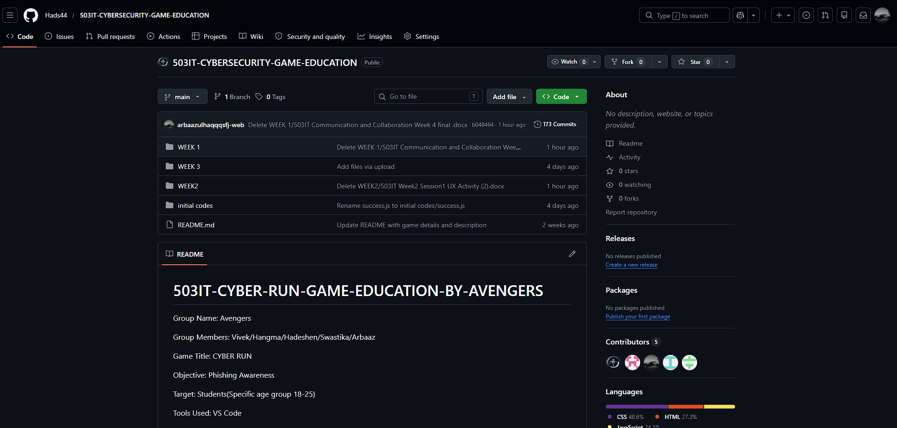
INFRASTRUCTURE & TEAM GIT
To support solid developer collaboration, we established professional-grade version control protocols:
▪
GitHub Repository Architecture setup with isolated developer branches.
▪
Created the initial codebase environment mapping main assets and stylesheet configs.
▪
Synchronized team meetings: Vivek (Tech Lead), Hadshen (Scribe), Hangma (UX / Presentation), Swastika (Appendices).

Slide 5
WEEK 2 AT A GLANCE
UX Evolution & Prototyping Tasks:
03
01
Prototype Planning Mapped core loop and scoring systems.
Storyboard Drafting Created interactive 6-frame UI flows.
04
02
Initial Coding Sprint Drafted CSS/JS layouts for the game.
Tool Selection Workshops Evaluated Scratch vs Construct 3 vs HTML5.

Slide 6
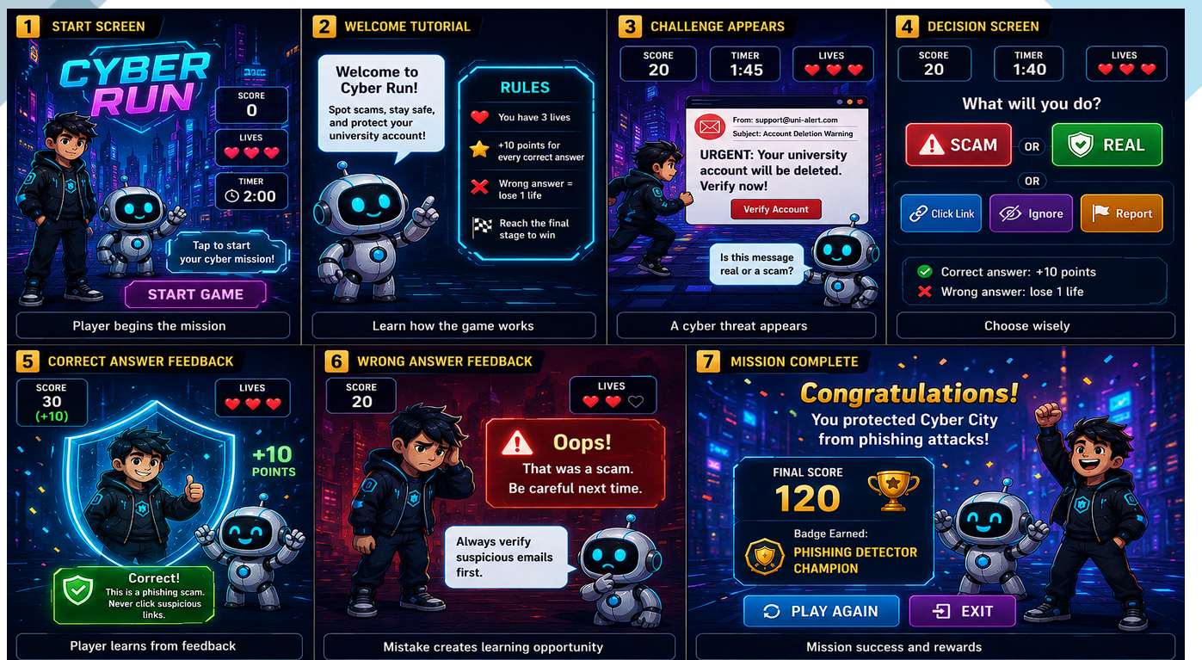
UX STORYBOARDING & INTERFACE
As documented in 503IT Week2 Session1 UX Activity.docx, we shifted our design focus to the player experience.
We finalized a high-contrast 6-frame storyboard displaying:
▪
Intuitive Onboarding: Seamless tutorial rules explaining score, lives, and timer.
▪
Dynamic Decision Space: Large, accessible response buttons (SCAM vs REAL) to limit visual strain.
▪
Bytebot Dialogue Prompts: Prompt, contextual popup feedback.

Slide 7





TOOL COMPARISON & DECISION
Following structured evaluations inside 503IT Week2 Session2 .docx and 503IT Week2 Session1 UX Activity (1).docx, the team prioritized rapid delivery and maximum access:
HTML5 / CSS / JS
Construct 3
Canva & Figma
Selected as our main technology. Ensures responsive cross-device performance and simple integration with our existing GitHub pipelines.
Considered for advanced game dynamics but rejected due to commercial licensing restrictions and code control difficulties.
Assigned strictly for mockup refinement, interface color contrast checks, and supporting storytelling storyboard designs.

Slide 8
WEEK 3 AT A GLANCE
Mechanics & Scenario Logic Tasks:
03
01
Playtesting Loops Resolved rapid click heart-loss glitches.
Advanced Scenario Engine Engineered pop-ups for random phishing lures.
04
02
Appendix Mapping Indexed team deliverables systematically.
Countdown Implementation Added 5-second dynamic action timers.

Slide 9






SCENARIO LOGIC & GAMEPLAY
5-Second Clock
Decision Core
Debounce Filters
Introduced a countdown bar mimicking the rapid urgency of clicking malicious email campaigns, building instant threat instincts.
Engineered isolated JS listeners assessing state parameters (Lives, Points, Badges) instantly reflecting player performance.
Fixed critical double-click scoring bugs. Implemented state lockout timers to maintain continuous structural play integrity.

Slide 10

TESTING & PORTFOLIO EVIDENCE
Guided by 503IT_Week3_Student_Task_Development_Presentation_Portfolio (1).docx, we mapped our codebase milestones directly into visual portfolio evidence:
Portfolio Appendix Strategy
▪
Tested internal prototype response speed across mobile and desktop.
Appendix 1.1 - 1.3: Team Weekly Minutes
▪
Developed an interactive, verified Appendix Map linking git code commits to project minutes.
Appendix 2.1 - 2.2: UX Canvas & Storyboards
Appendix 3.1 - 3.2: Version 1 & 2 Prototype links
▪
Prepared the 15-minute presentation speaking slots to highlight personal development outcomes.
Appendix 4.1: Peer Feedback Evaluations

Slide 11
WEEK 4 AT A GLANCE
Polish, Optimize & Deployment Tasks:
03
01
Cross-Browser Debugging Ensured perfect rendering on modern engines.
Accessibility Tuning Upgraded text contrast to AAA compliance.
04
02
Deliverables Compilation Exported code packages to GitHub organization.
Performance Diagnostics Tested scenario loader latency scores.

Slide 12
SYSTEM POLISH & OPTIMIZATION
Universal Design Adjustments
Presentation Compilation
Applied clear visual feedback from our peer testing groups. Added bright green success highlights and strong red warning glows surrounding interactive dialogue windows.
Synchronized slides with details directly from our CYBER RUN Development Showcase - Google Slides.pdf master portfolio.
Ensured precise synchronization of speaking points for our team's showcase run.
Ensured AAA contrast ratios, prioritizing clean viewing on diverse portable devices.

Slide 13
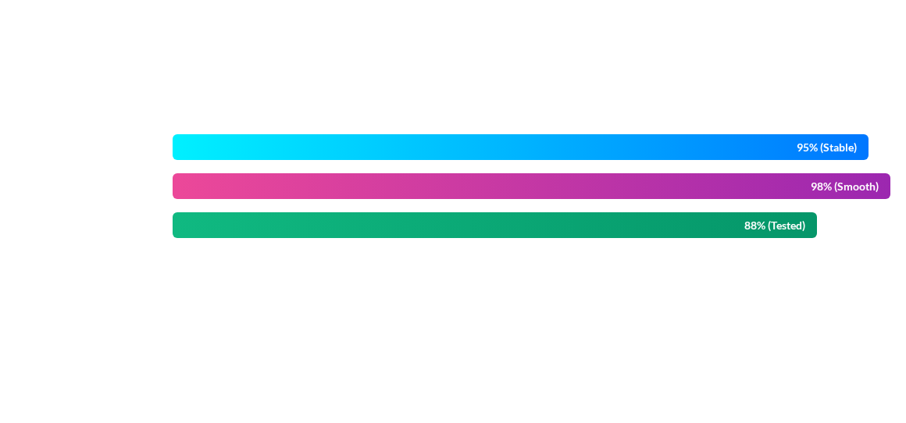
PERFORMANCE DIAGNOSTICS
Final performance sprints successfully optimized randomized scenario script injection and updated CSS grid configurations for diverse viewport targets.

Slide 14
Thank you for exploring our 4-week Cyber Run development journey.
The Avengers

